Slide 1

Nested if elif else statements

Slide 2
if else statements
if condition:
# Code to execute if True
else:
# Code to execute if False

Slide 3
Nested if else statements
if condition1:
# Code to be executed if condition1 is True
if condition2:
# Code to be executed if condition2 is True
else:
# Code to be executed if condition2 is False
else:
# Code to be executed if condition1 is False

Slide 4
Nested if elif else statements
if condition1:
# Code to be executed if condition1 is True
if condition2:
# Code to be executed if condition2 is True
elif condition3:
# Code to be executed if condition2 is True
else:
# Code to be executed if conditions are False
else:
# Code to be executed if condition1 is False

Slide 5
if elif else statements
if statement: Checks the first condition. If it's true, the code block under it is executed, and the rest of the conditions are ignored.
elif statements: These are optional and can be used multiple times. Each elif checks its condition only if the previous if and elif conditions were false.
else statement: This is also optional. It's executed if none of the previous conditions were true.

Slide 6


Nested if elif else statements

Slide 7
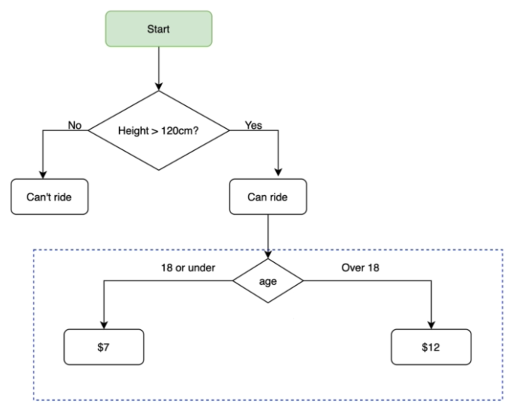
Flow Chart

Slide 8
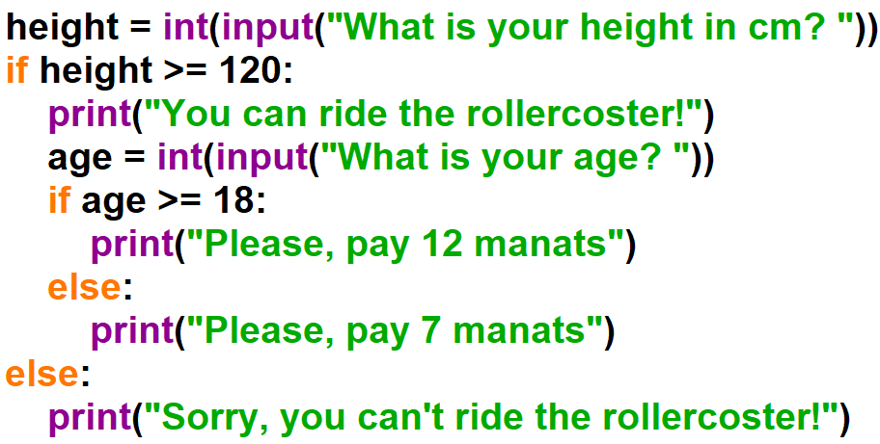

Example:

Slide 9

Nested if elif else statements

Slide 10
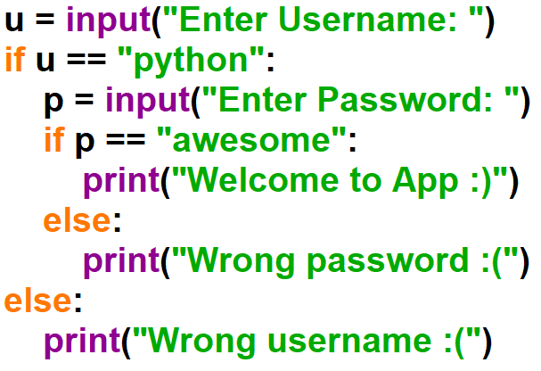

Example:

Slide 11
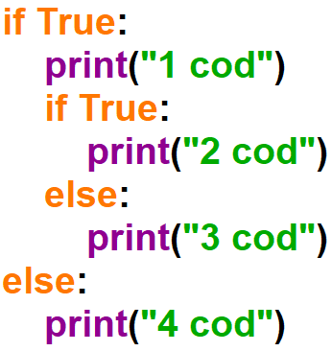

Example:

Slide 12
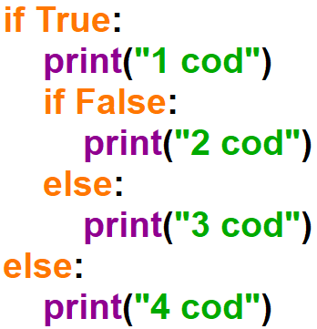

Example:

Slide 13
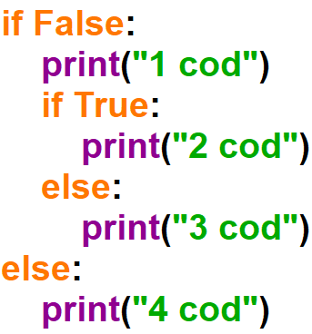

Example:

Slide 14


